Slide 1


Batho Pele Hospital Intake AI
Prepared by: Mpho Hlalele- Contact: mphohlalele90@gmail.com | Linkedin: MphoHlalele | Portfolio | Github Mphohlalele90
A Smart System for Ethical, Efficient Patient Verification in Public Hospitals

Slide 2


Problem:
South African public hospitals suffer from administrative delays, undocumented patients, and under-resourced facilities.
No tech support for verifying citizenship or legal status
Bed shortages, medicine theft, long waits
Citizens struggle to access care equitably

Slide 3

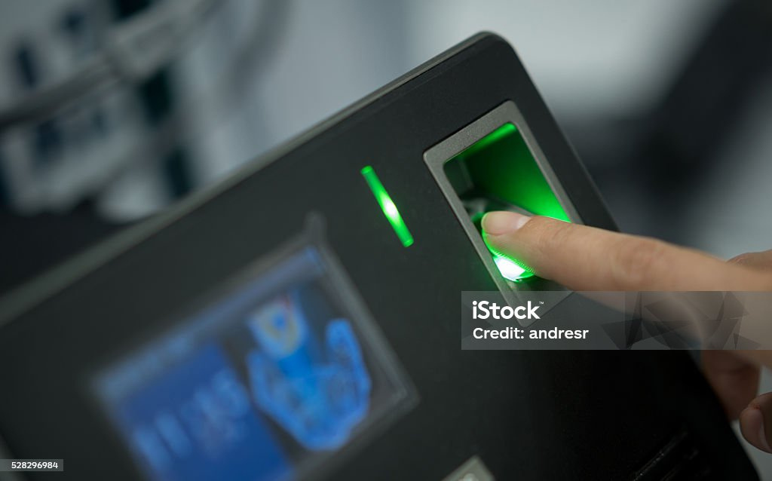
Solution:
A Python (Streamlit) app for automated, ethical patient intake and resource management
Automated patient data collection and verification- Rule-based identity checks for fairness- Real-time dashboards on hospital resources- Metrics by demographics and legal status

Slide 4

Key Features of AI System
01
Automation
Automated flagging of mismatched patient data
02
Testing
Unit tests for form fields and logic
03
Modularity
Code split into modules: app.py, document_verifier.py, data_loader.py, reporting.py

Slide 5
Key Features of AI System
04
Version Control
Git/GitHub for collaboration and CI

Slide 6
Tech Stack Overview
01
Languages/Frameworks
Python, Pandas, Streamlit
02
Infrastructure
Streamlit Cloud, GitHub, logging for audit
03
Design
Lightweight (no GPU), ideal for resource-limited clinics

Slide 7
App Workflow
Intake Form :
Patient details
nationality, document type - Automated
checks for legal status
Doctor notes and diagnosis
Verification Logic
Rule-based (see `document_verifier.py`)
Flags but does not deny care
Resource Dashboard
Bed, medication, staff availability (real-time)
Patient stats by demographic
Reporting
Exportable summaries for NGOs/government

Slide 8
01
Fairness
Ethical Guardrails Overview
Flags for undocumented/foreign patients ethically
02
Inclusivity
Equal treatment; verification guides only
03
Energy Efficient
Runs on standard hardware.

Slide 9
Ethical Guardrails Overview
04
Bias Mitigation
No exclusion by nationality; transparent logic
04
Equity-Driven Decision Logic
The system applies fair, policy-based rules to guide healthcare access without bias.

Slide 10
SDG Alignment Commitment
01
Commitment to SDG 3: Health Access
Ensuring equitable healthcare for all citizens.
02
Commitment to SDG 10: Inequality Reduction
Prioritizing services for legally entitled patients.
03
Commitment to SDG 16: Improved Governance
Enhancing transparency and reducing healthcare fraud.

Slide 11

Impact
Reduced Manual Errors: Fast, accurate intake-
Better Planning: Real-time resource stats for staff
Improved Reporting: Reliable data for NGOs/government
Scalability: Ideal for clinics/hospitals with few resources

Slide 12



Contact Information
mphohlalele90@gmail.com
www.linkedin.com/in/mpho-hlalele-b9240566
0815140346

